Slide 1
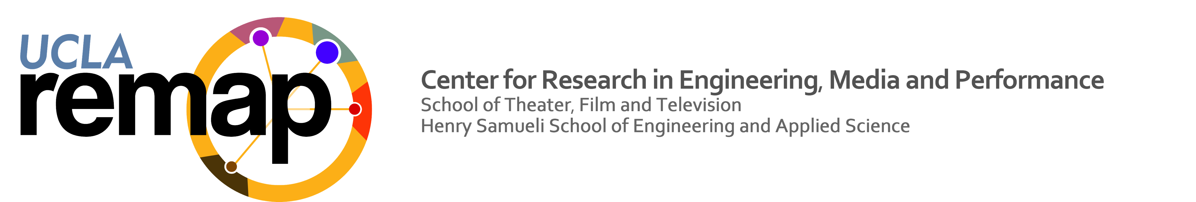
Named Data Networking of Things: Example Application “FLOW”
Zhehao Wang, Eitan Mendelowitz, Zoe Sandoval, Jeff Burke
ABSTRACT
NAMING AND MESSAGE EXCHANGE
Flow is a prototype home entertainment application using Named Data Networking. It provides an exploratory experience in which a player navigates and interacts with a virtual environment via person tracking (OpenPTrack), wearable devices (gyroscope), and their mobile phone.
To develop Flow, we designed and implemented the Named Data Networking of Things (NDN-IoT) framework, libraries in multiple languages that implement naming, trust and bootstrap, discovery, and application level publish/subscribed based on the NDN team's IoTDI '16 paper, to explore IoT-based application development in a home environment.
This poster gives an overview of NDN-IoT framework functionality, namespace and trust relationship in the Flow application, as well as message flows in the installation.
1. Application Bootstrap
Messages exchanged between controller and an added device in the first step of bootstrapping, adding the device to the home network.
1
2. Trust Relationship
Messages exchanged in the second step of bootstrapping: requesting producing authorization as a producer, or requesting application trust schema as a consumer. The resulting trust relationship follows the "trust relationship example" section of the IoTDI 2016 paper.
2
NAMED DATA NETWORKING OF THINGS: CODE FRAMEWORK
3. Namespace
This figures shows the namespace after the bootstrap is done, including what interest(I) and data(D) names the Flow application uses by default.
Arrows denote the direction of an interest.
Each component has a name in the device namespace, as well as application prefixes if they serve as producers in the Flow application.
The NDN-IoT framework built on top of NDN Common Client Libraries, and implements the following functionality in JavaScript, Python, C# and C++:
Naming (section VI.A of Shang, et al., 2016): the framework uses three levels of names, manufacture-level, device-level, and application-level, which differentiates the naming of devices, things and their data in a home environment.
Trust and bootstrap (VI.B and VI.C): the framework provides functionality for setting up an initial keyChain and identity, and a setting up as a producer and/or consumer.
Discovery (VI.B): the framework implements a sync based name discovery mechanism similar to ChronoSync (Zhu & Afanasyev, 2013)
Application-level pub/sub (VI.F) the framework provides consumer abstractions for a timestamp-based namespace, as well as a sequence-number-based namespace.
3
FLOW APPLICATION
The Flow application uses an industry-standard game engine, Unity, to implement a flying experience controlled by multiple specialized wearable devices (future game controllers), computer vision using commodity hardware (Kinect v2, etc.) and users’ mobile phones. It is based on a multi-person cultural experience prototype being prototyped for California State Parks in 2017.
Shang, W., A. Bannis, T. Liang, Z. Wang, Y. Yu, A. Afanasyev, J. Thompson, J. Burke, B. Zhang, L. Zhang. (2016, April). Named Data Networking of Things. IEEE First International Conference on Internet-of-Things Design and Implementation (IoTDI), April 2016.
Shang, W., Z. Wang, A. Afanasyev, J. Burke, L. Zhang. A Cloud-independent Home Entertainment Design over Named Data Networking of Things. ACM/IEEE Second International Conference on Internet-of-Things Design and Implementation (IoTDI), April 2017.

